Slide 1
Artificial Intelligence
Course Code: CS-202
Topic: Intelligent Agents and their types, Rationality
Instructor: Habiba Arshad

Slide 2
Today’s Goal
Intelligent Agents
Characteristics of Intelligent Agents
Agents Interaction Cycle
Why study intelligent agents?
Rationality
PEAS

Slide 3
This week lecture will cover the following CLO:
CLO1: Discuss the key concepts in the field of artificial intelligence

Slide 4
Intelligent Agent

Slide 5

Intelligent Agents
What is an agent?
An agent is anything that
perceiving its environment through sensors
acting upon that environment through actuators
Example:
Human is an agent
A robot is also an agent with cameras and motors
A thermostat detecting room temperature
Human agent: eyes, ears, and other organs for sensors; - hands, legs, mouth, and other body parts for actuators
Robotic agent: cameras and infrared range finders for sensors -various motors for actuators
Notes:
An actuator is a part of the agent that delivers the output of action to the environment. They are responsible for executing the actions decided by the agent based on its perceptions and decisions. In essence, actuators are the “hands and feet” of the agent, enabling it to carry out tasks.

Slide 6
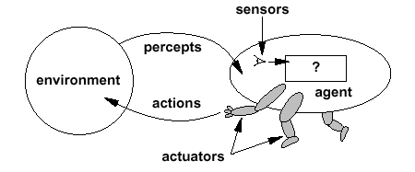
Intelligent Agents
The agent function maps from percept histories to actions:
[f: P* → A]
The agent program runs on the physical architecture to produce f
agent = architecture + program

Slide 7
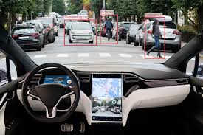
Examples of Intelligent Agents
Self-Driving Cars
Perceive road conditions and make driving decisions.
Virtual Personal Assistants (e.g., Siri, Alexa)
Respond to voice commands and perform tasks.
Robots in Manufacturing
Automate tasks by perceiving object positions and adjusting actions.

Slide 8
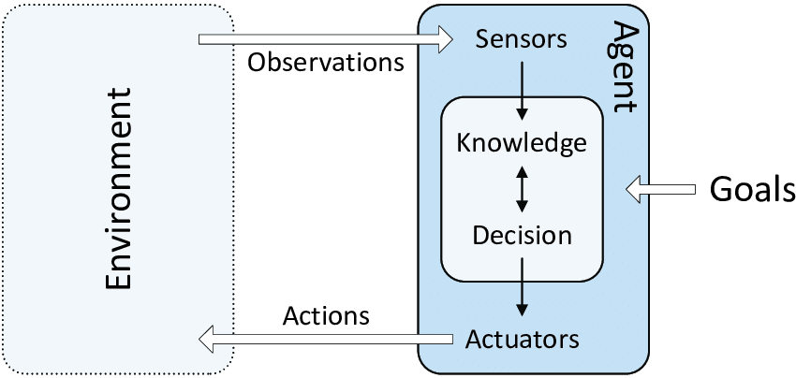
Agent's Interaction Cycle
Perception
Collects information about the environment.
Reasoning/Decision Making
Uses the information to make decisions.
Action
Performs actions to affect the environment.

Slide 9
Why Study Intelligent Agents?
Understanding intelligent agents helps develop better AI systems that can solve complex, real-world problems.
Foundation for AI applications across various fields like healthcare, finance, gaming, and robotics.

Slide 10

Characteristics of Intelligent Agents
Autonomy:
Capable of making decisions without human intervention.
Reactivity:
Responds to changes in the environment.
Proactivity:
Takes initiative to achieve its goals.
Social Ability:
Can interact with other agents or humans to fulfil its objectives.

Slide 11
The Concept of Rationality
Rationality
Rationality means making the best possible decision based on the information available. A rational agent chooses actions that lead to the best expected outcome.
Factors influencing rationality:
Performance Measure – How success is defined for the agent.
Percept Sequence – What the agent has sensed or observed over time.
Knowledge of the Environment – What the agent knows about the world.
Available Actions – The choices the agent can make.

Slide 12
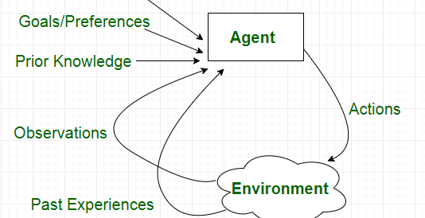

Slide 13
PEAS
PEAS is a framework used to define the structure of an intelligent agent by identifying four key components:
Performance Measure – The criteria that define the success of the agent’s actions (e.g., accuracy, speed, efficiency).
Environment – The surroundings in which the agent operates (e.g., a chessboard, a self-driving car's road).
Actuators – The parts that allow the agent to take action (e.g., robot arms, car wheels).
Sensors – The parts that gather information from the environment (e.g., cameras, microphones).

Slide 14
Cont…
The performance measure determines what counts as a good decision, while the environment, actuators, and sensors influence how well the agent can perceive and act.
A rational agent uses these components to make the best possible choices.

Slide 15
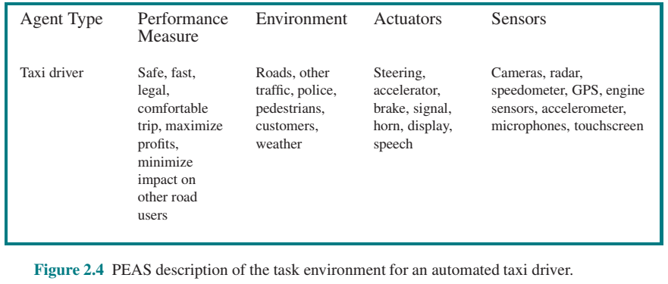
Nature of environments
A sketch of automated taxi driver

Slide 16
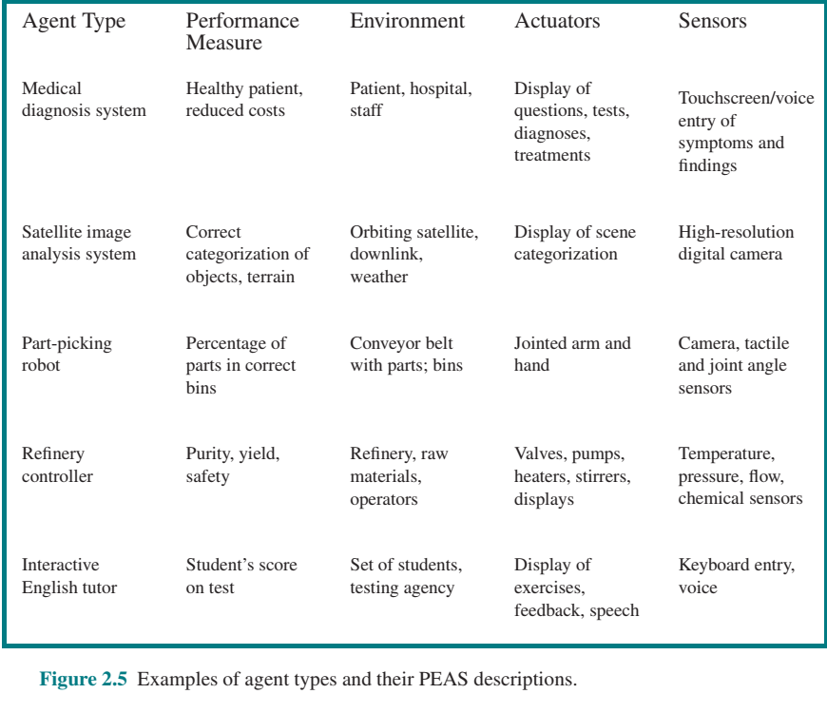

Slide 17

Any Question?

